Slide 1
Restaurant Analysis
Aditya Deepak Nayar

Slide 2
Need for restaurant analysis
Different places in a city will have different tastes
Restaurants of different cuisines might be more in some areas
Helps to classify restaurants ay cuisine in different neighbourhoods
To help chefs and restaurant chains choose the right location for their restaurant
To help visitors find the most popular places nearby them

Slide 3
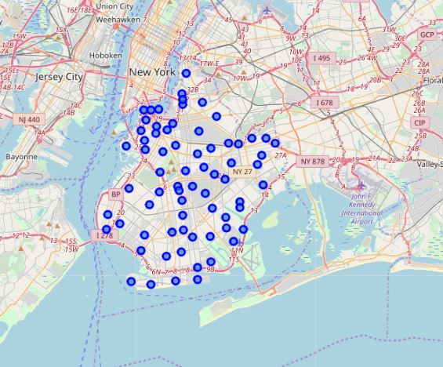
Brooklyn, New York chosen for analysis

Slide 4
Data acquisition
Data on New york neighbourhoods acquired from https://geo.nyu.edu/catalog/nyu_2451_34572 in json format
Json file converted to dataframe and neighbourhoods not in Brooklyn were filtered out
Venue details acquired from Foursquare API by sending multiple requests

Slide 5
Data Cleaning
Data obtained from Foursquare was converted into one hot encoding to enable clustering
Venues that were not restaurants or eateries were filtered out
Frequency of each venue was found
Data frame was made showing restaurants in decreasing order of popularity for each neighbourhood

Slide 6
Modelling
As neighbourhoods had to be grouped according to restaurant category an unsupervised algorithm was required
K – means clustering was used for the above case as it was the correct algorithm for the given kind of data
The elbow method was used to find the best value of k (no. of clusters)
Here optimum value was found to be 4

Slide 7
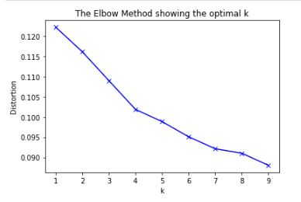

Slide 8
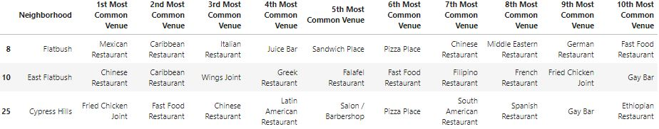
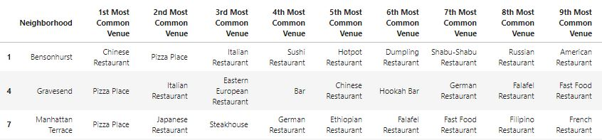
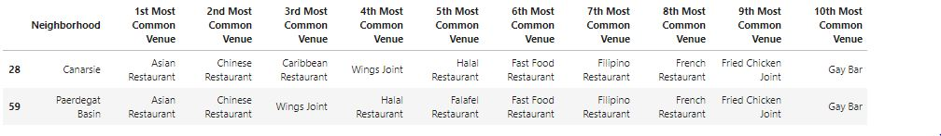
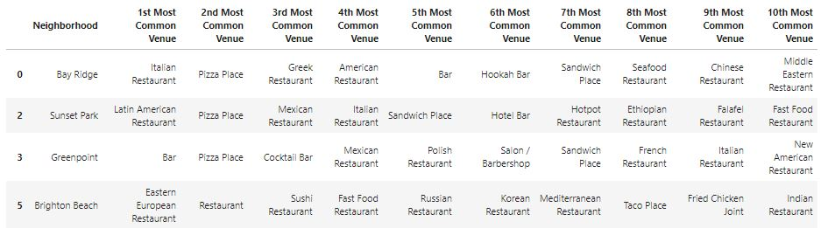
Following clusters obtained
Cluster1
Cluster2
cluster3
cluster4

Slide 9
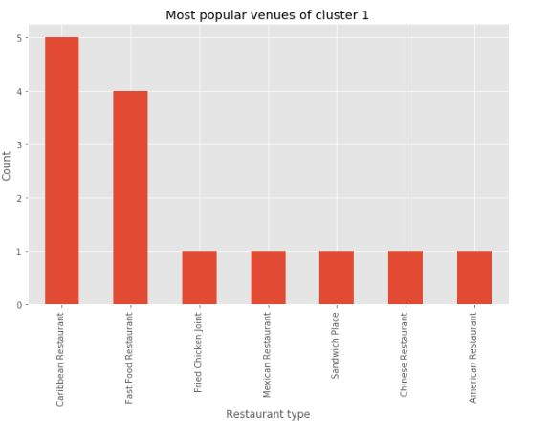
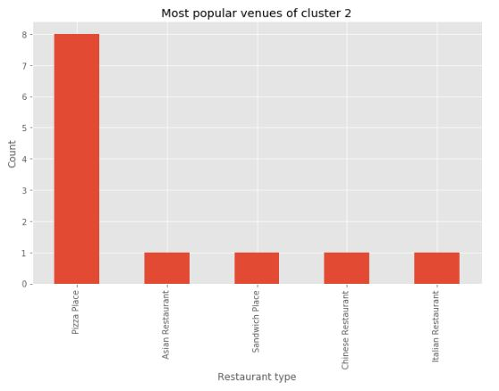
Most popular restaurants in each cluster

Slide 10
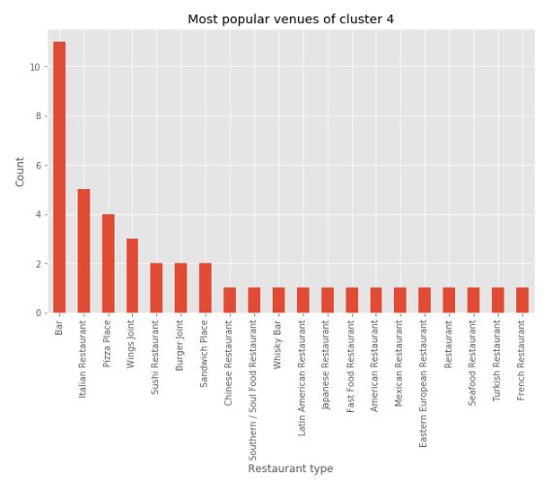
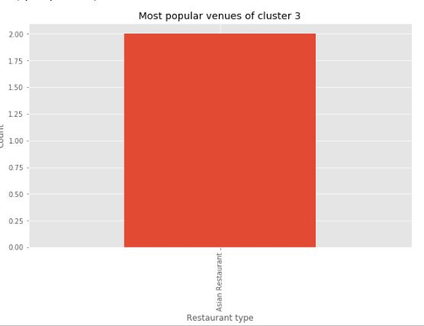

Slide 11
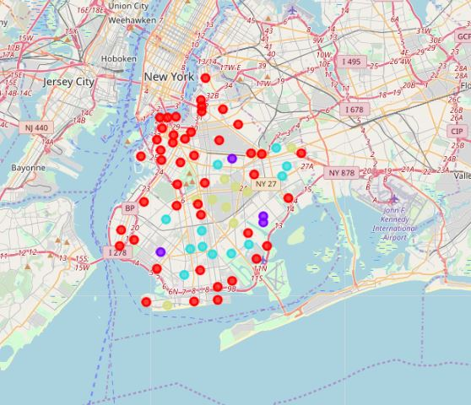
Map showing clustered neighbourhoods

Slide 12
Thank You

